Slide 1


Innerlayer Copper Balancing Phase 2
Team Leader:
Asa Guest, IBM
Facilitator:
Karl Sauter
Implementation
Host: Panasonic
February 27, 2025
© HDP User Group International

Slide 2
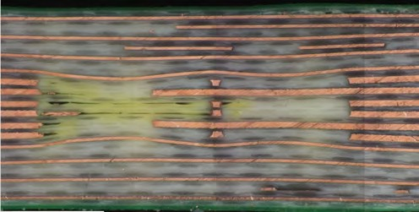
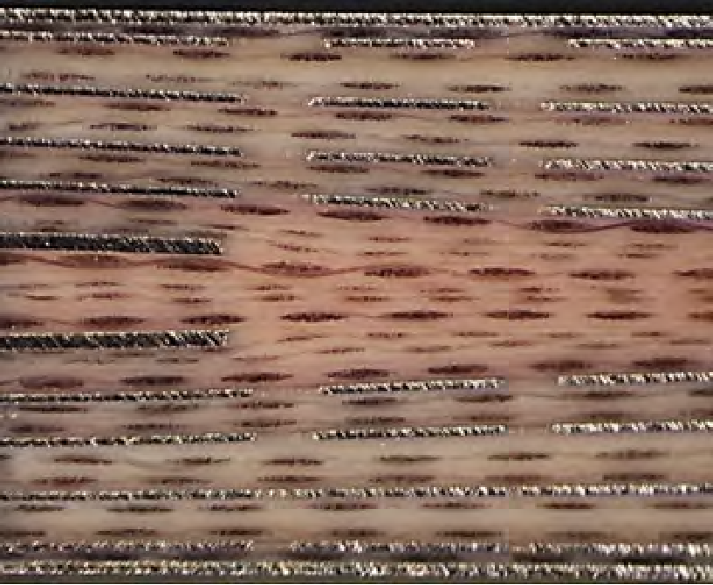
Background
Localized areas of Innerlayer Copper Imbalance can result in localized innerlayer core deformation.
Increasing Zo variation across high speed channels
Increases risk of Lamination voids, micro fracturing under large components
Increased warpage & non-linear scaling
Increases uncertainty/variation of layer z-axis location:
Increasing backdrill stub variation
Increased surface topology variations
Extent of Core deformation & Sensitivity to Inner Layer Copper Imbalance is an interaction between material selection and stackup.
Project Phase 1: Quantified sensitivity of void size and density stacking on core deformation, Surface topography for assembly, and recommended design approaches focused on Low Loss and Ultra Low-Loss laminates.
02/27/2025

Slide 3
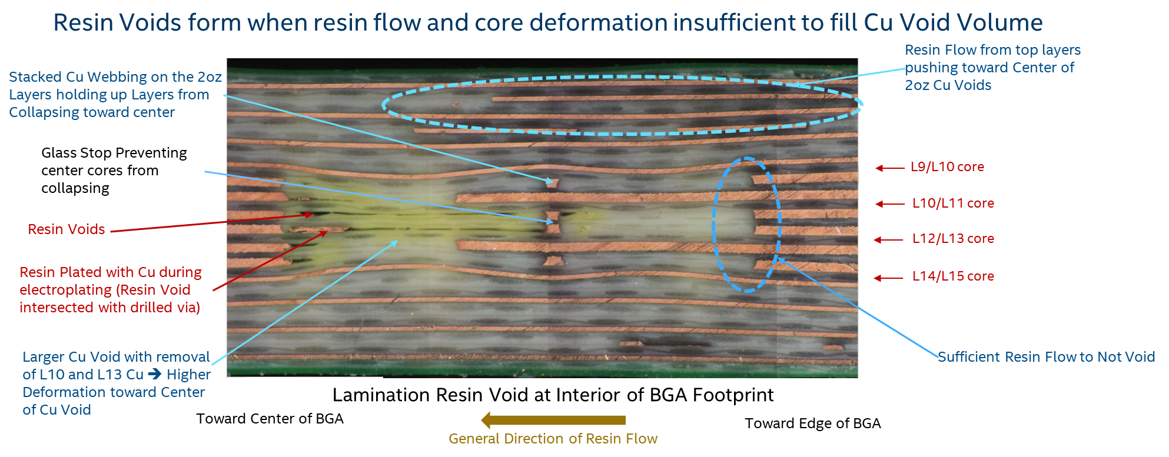
Phase 2 Motivation: Core Deformation and Insufficient Resin Fill
02/27/2025

Slide 4
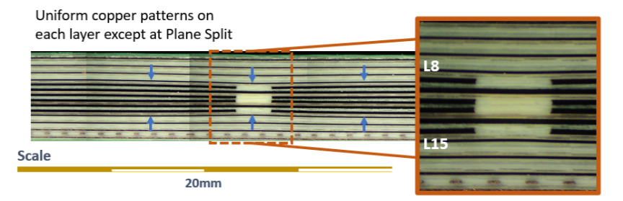
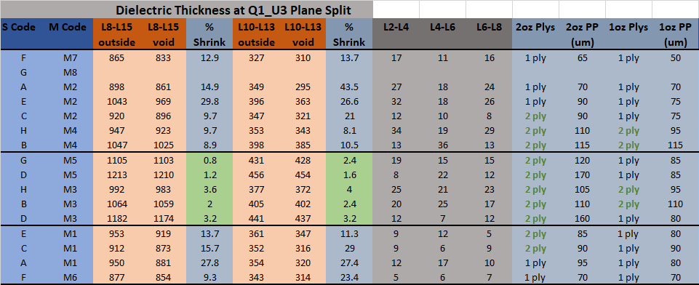
Phase 2 Motivation : Stackup and Material Selection
Preventing core deformation requires filling voids on adjacent layers at same rate
When copper void volume is different between adjacent layers ➔ prepreg thickness needs to be selected so that void fill rates are similar (most prominent with change in copper thickness)
Post Lamination
Higher flow materials
High deformation with high flow
Minimal deformation with either lower or higher flow when prepreg thickness match void volume ratio
Lower flow materials
High deformation with low flow
02/27/2025

Slide 5
Project Deliverables Phase 2
CAD translator utility available to members that will provide analysis of local copper distribution to identify risk areas for:
Core deformation and backdrill stub variation
Surface topography variations
Local areas of glass stop
Potential feasibility to model extent of core deformation and/or surface topography variations.
Additional validation of the coplanarity and core deformation mitigation of using sub lam sequence and stack-up optimization.
Phase 1 was a "hammer test" with respect to design
Goal is to quantify extent that construction stack-up can overcome unbalanced designs
02/27/2025

Slide 6
Member Benefits
OEM & Designers: Design guidelines for optimizing copper distributions;
Minimize Impedance variations not captured in Zo coupons
Minimize backdrill stub length variations under large BGAs
Insight to influence of core deformation from copper distributions on dynamic warpage.
Characterization of material properties and design on Surface Deformation
ODMs: Understand the impact of copper distributions on dynamic warpage and impact on boot issues w.r.t impedance (Zo) variations and/or stub control.
PCB Fabricators: Ability to highlight potential risk areas for designers and understand to what extent resin material flow properties modulate core deformation issues vs copper distribution.
Laminate Suppliers: Insight into the interaction between resin flow properties and design/ stackup parameters on core deformation.
02/27/2025

Slide 7
Member Benefits - Continued
The ability to automate the design analysis of designs for local copper balancing; reducing design costs, and time allowing more consistent electrical and topographical performance of the copper fill technique.
Additional validation of the coplanarity and core deformation mitigation of using sub lam sequence and stackup optimization. This will assure copper fill design rules are correct.
02/27/2025

Slide 8
Assumptions/Disclaimers
Blurring algorithms are used as rough approximations to capture Cu density
Current algorithm assumes uniform ‘resin’ flow (kernel size is constant)
Meant to supplement other methods
DFX
Manufacturing experience
Etc.

Slide 9
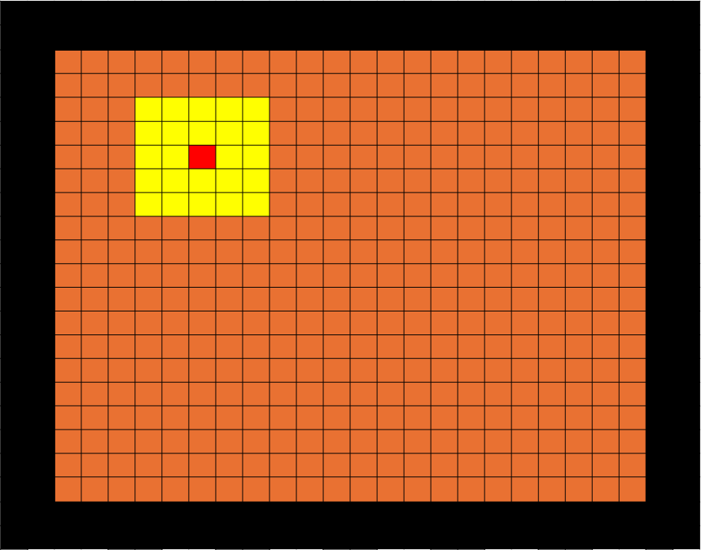
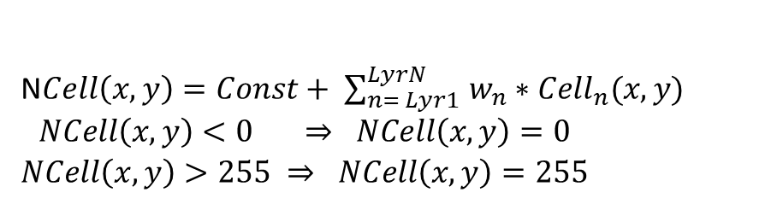
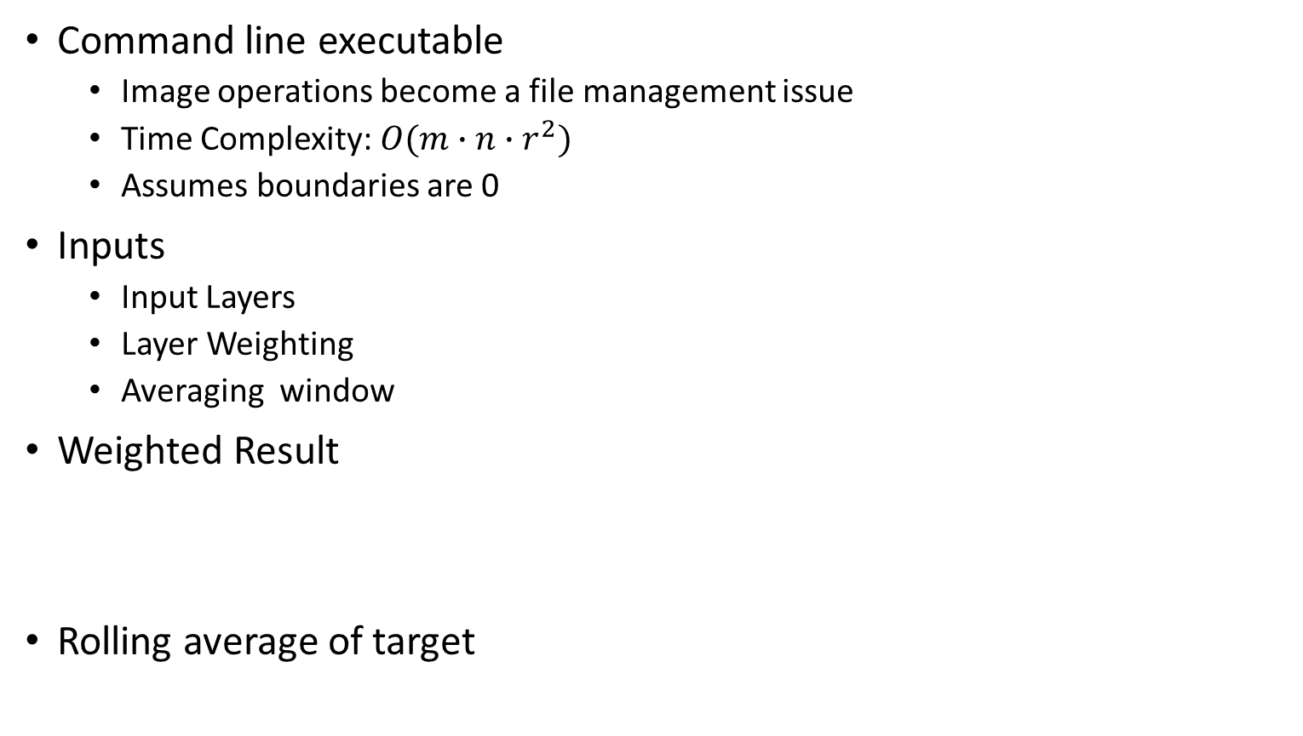
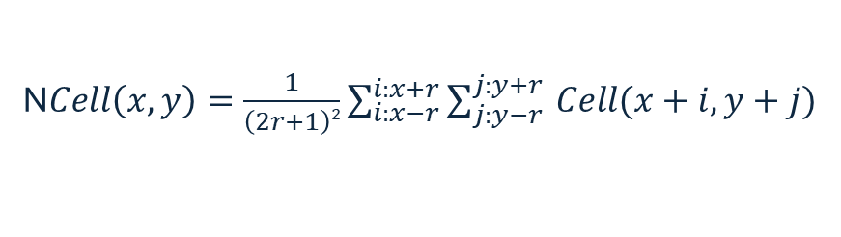
MetAve algorithm (Box Filter)
Command line executable
Image operations become a file management issue
Time Complexity: $O({m∙n∙r}^{2})$
Assumes boundaries are 0
Inputs
Input Layers
Layer Weighting
Averaging window
Weighted Result
Rolling average of target
Ncell(x, y)
N$Cell\left(x,y\right)=Const+ \sum_{n= Lyr1 }^{LyrN}{w_{n}∗{Cell}_{n}(x,y)}$
$$\begin{matrix}NCell\left(x,y\right)<0 ⇒ NCell\left(x,y\right)=0 \\ NCell\left(x,y\right)>255 ⇒ NCell\left(x,y\right)=255\end{matrix}$$
r = 2
N$Cell\left(x,y\right)=\frac{1}{\left(2r+1\right)2}\sum_{i:x−r}^{i:x+r}{\sum_{j:y−r }^{j:y+r}{Cell(x+i,y+j)}}$

Slide 10
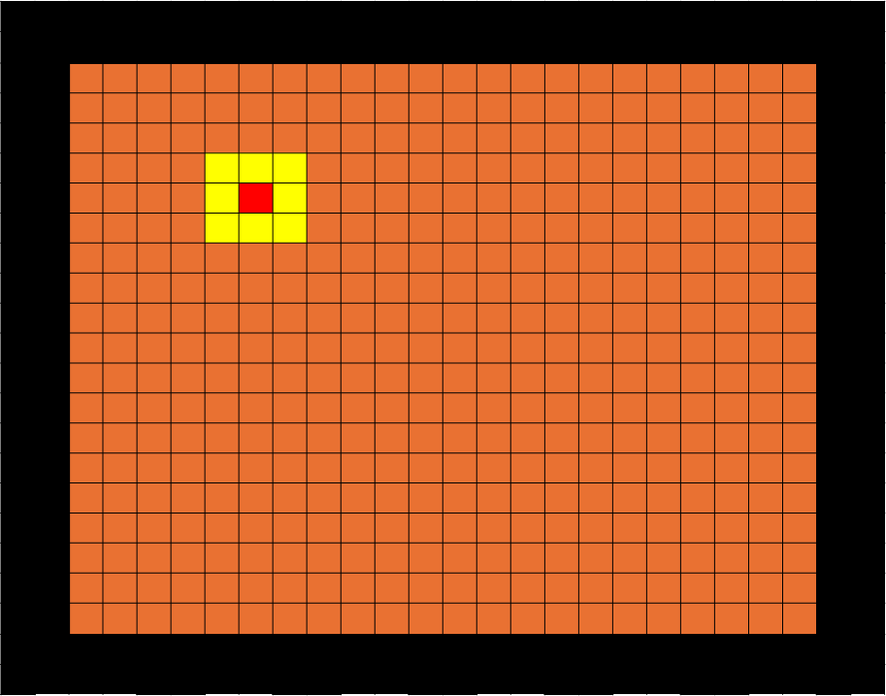
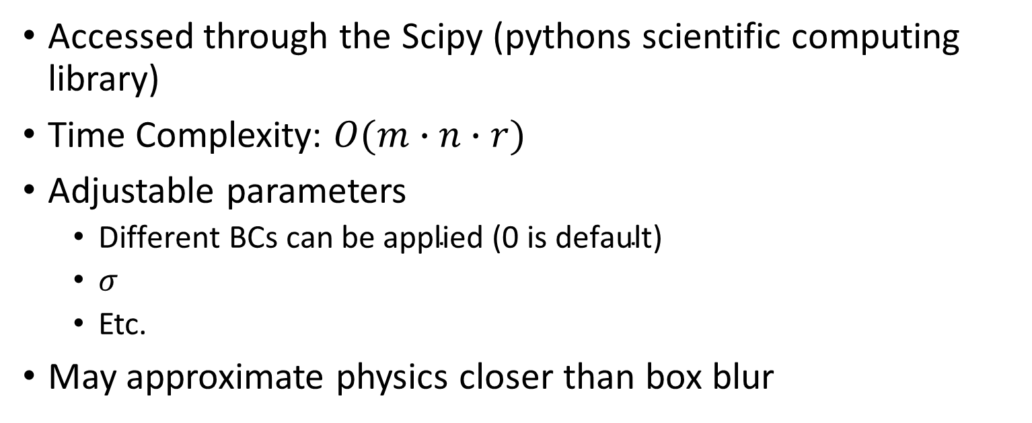
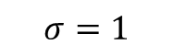
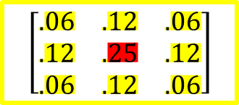
Gaussian Algorithm
Accessed through the Scipy (pythons scientific computing library)
Time Complexity: $O(m∙n∙r)$
Adjustable parameters
$\text{Different} \text{BCs} \text{can} \text{be} \text{applied}\text{ (0 }\text{is} \text{default}\text{)}$
$σ$
Etc.
May approximate physics closer than box blur
$$σ=1$$
$$\left[\begin{matrix}.06 & .12 & .06 \\ .12 & .25 & .12 \\ .06 & .12 & .06\end{matrix}\right]$$

Slide 11
Additional Algorithms To be Added
Median Filter
May require multiple passes
Bilateral Filter
Like Gaussian near strictly copper or strictly ‘prepreg’ regions
Open to adding others

Slide 12
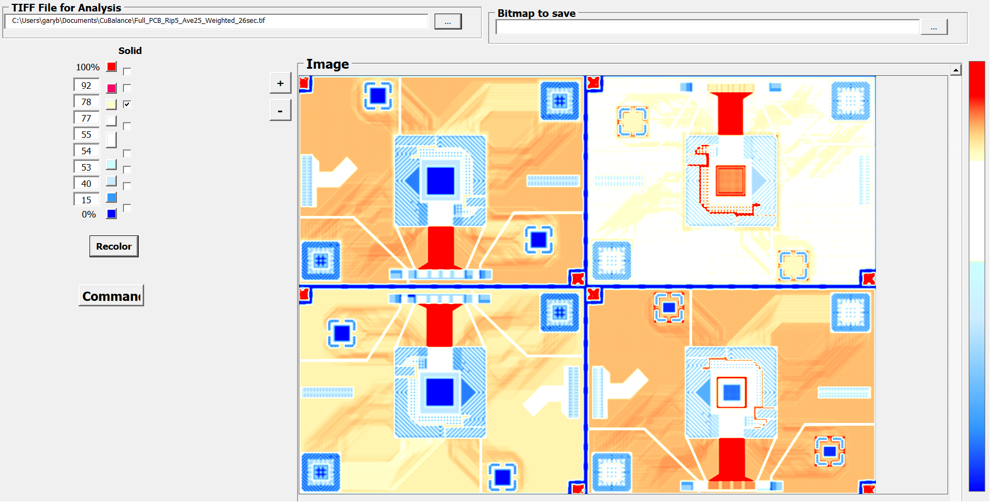
Past Work: Copper Balancing Analysis
API utility from “Artwork Conversion Software, Inc.”
Provide rolling grey scale average over a specified sliding window and window stepping for a single layer
Allowing layer analysis w.r.t flow distances/properties of resin
Ability to predict where deformation will start, locations of min/max deformation
Provide ability to Add/Subtract multiple grey scale layers using layer weighting
Initial Wrapper created
to utilize API utility and
visualize results
Total Copper
Pixel size: 5x5mil
650um
Visualization of 20% added thieving on signal layers
0um
02/27/2025

Slide 13
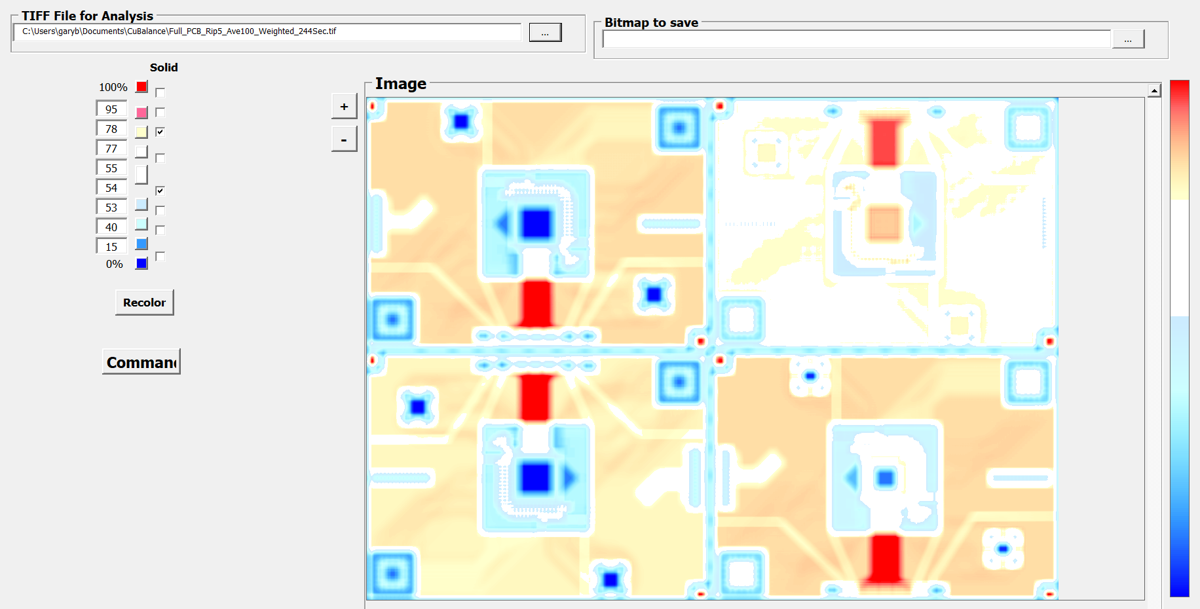
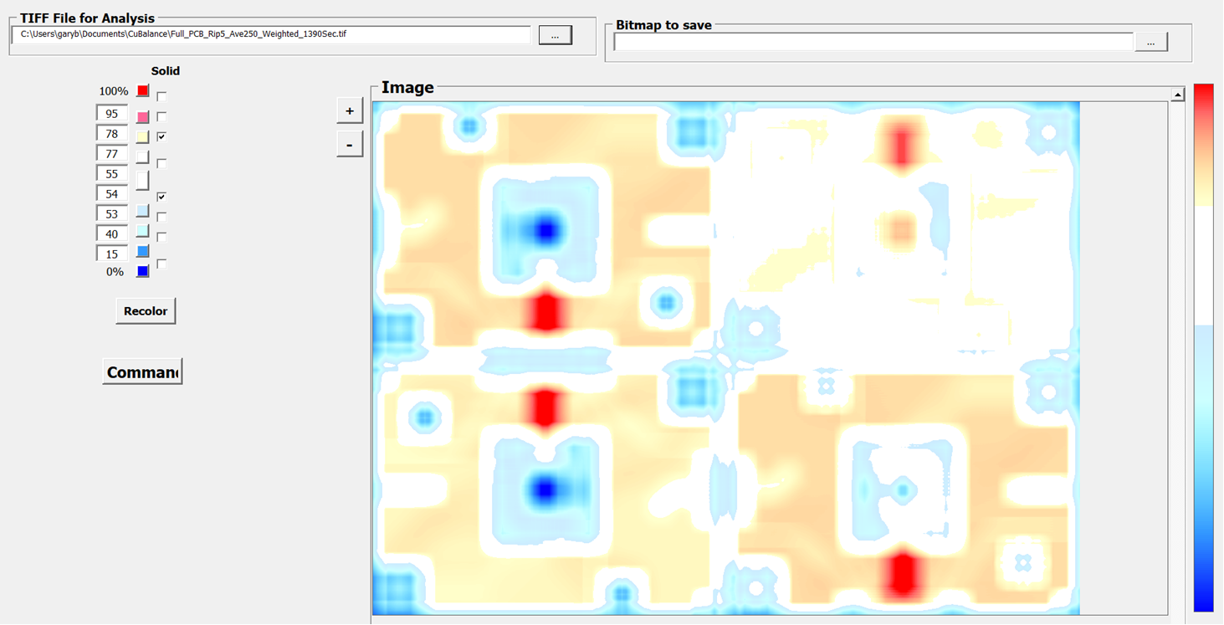
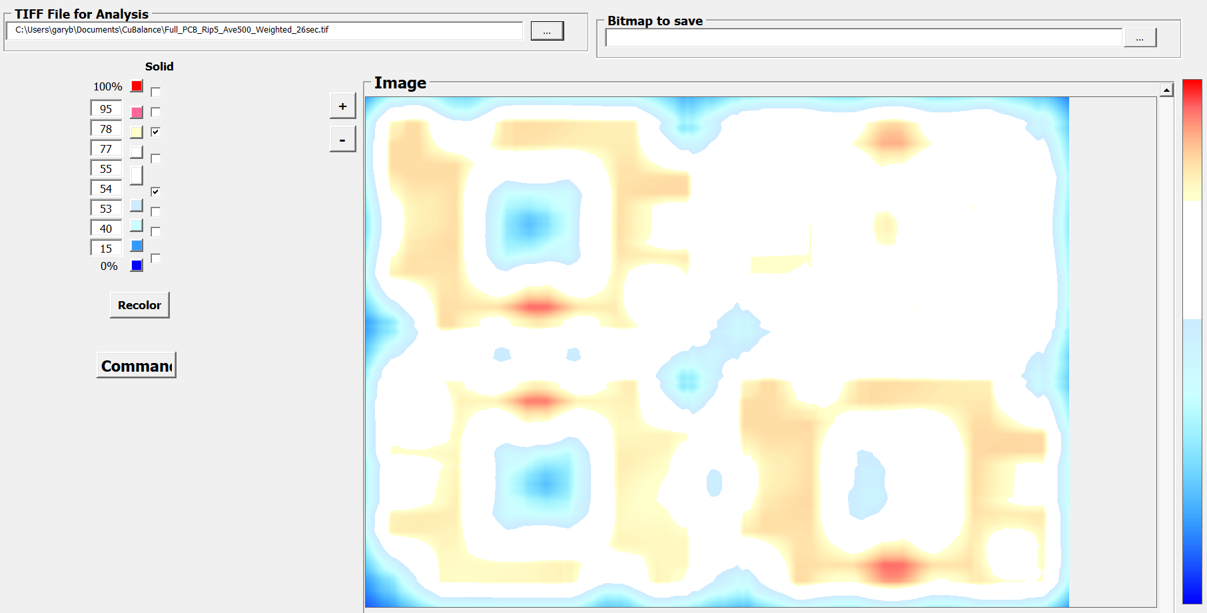
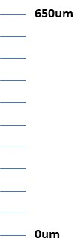
Status: Copper Balancing Analysis
Example of Rolling Average over different distances
Pixel size at 5x5 mil
Color bands around panel average
0.5 inch
1.25 inch
2.5 inch
Asymmetry of average thickness
Rolling average much better then simple averaging within a set grid w.r.t Maintaining a level of local detail otherwise hidden
02/27/2025

Slide 14
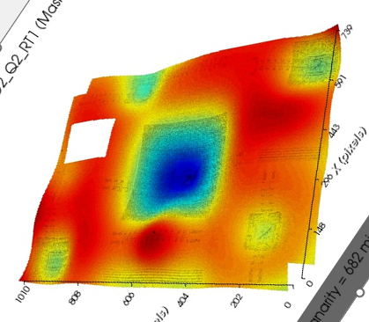
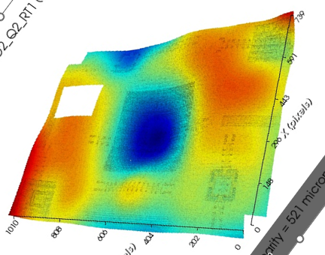
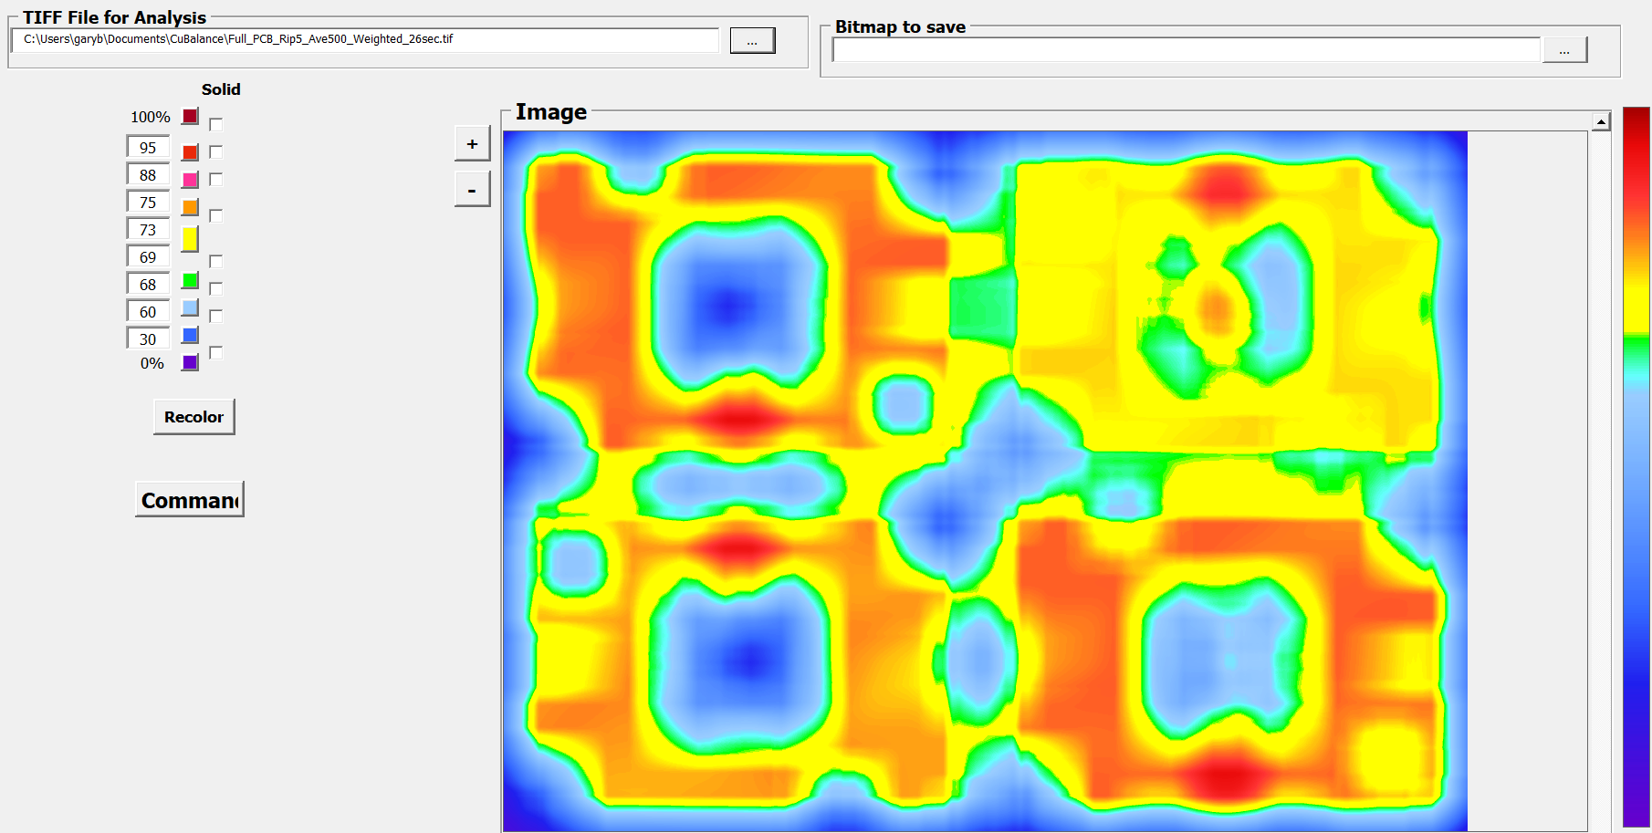
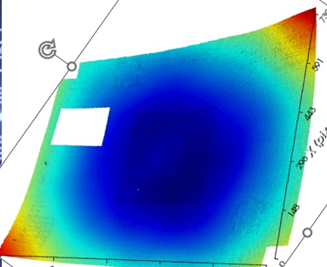
Status: Copper Balancing Analysis
Panel 2, Mtrl A
Panel 1, Mtrl B
Measured coplanarity variation of Q2
Shadow Moire
650um
Total copper map of Q2 with rolling average
General patterns hold
Basic Shape of High/low areas
Location of Low/High Areas
Except when they don’t:
0um
Panel 1, Mtrl A
02/27/2025

Slide 15
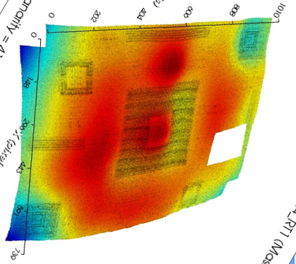
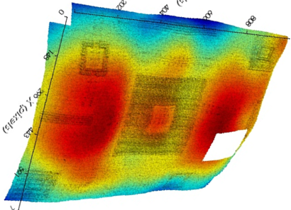
Status: Copper Balancing Analysis
Panel 2, Mtrl A
Panel 1, Mtrl C
Measured coplanarity variation of Q4
Shadow Moire
650um
General patterns hold
Basic Shape of High/low areas
Location of Low/High Areas
Total copper map of Q4 with rolling average
As expected: Total Cu map as an indicator of coplanarity will be best when Local Thickness variations are dominate factor in Coplanarity
0um
02/27/2025

Slide 16


Color Thresholds
Changing color threshold mute or accent patterns and gradient detail
White bands good for mapping areas to address with design
Full bands (jet, nipy_spectral) appear to have better visual correlation with Shadow-Moire measurements
650um
0um

Slide 17
Interface Updates
Develop Interface for users to input stack up information/Gerber data
Assign Layer Details (Cu Weight, core/PP thickness)
Pixel size is user defined
Additional Averaging algorithms
Additional Image Options
Pan/Zoom/Rotate
Colorization (User Color Schemes Added)

Slide 18
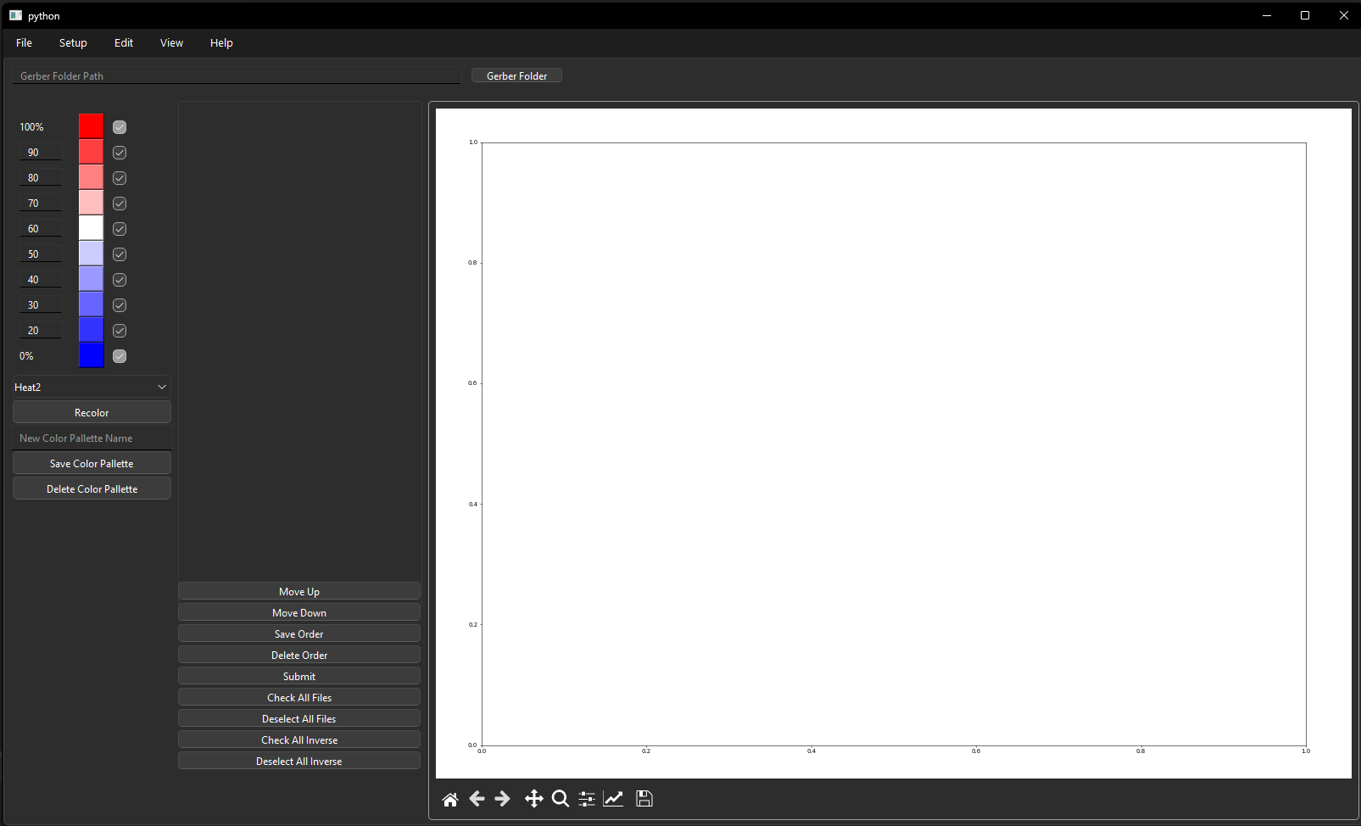
Interface Updates
Gerber to Tiff In App
Preset/User defined color mappings
Operations for stack up information from Gerber layers
In App Image View

Slide 19
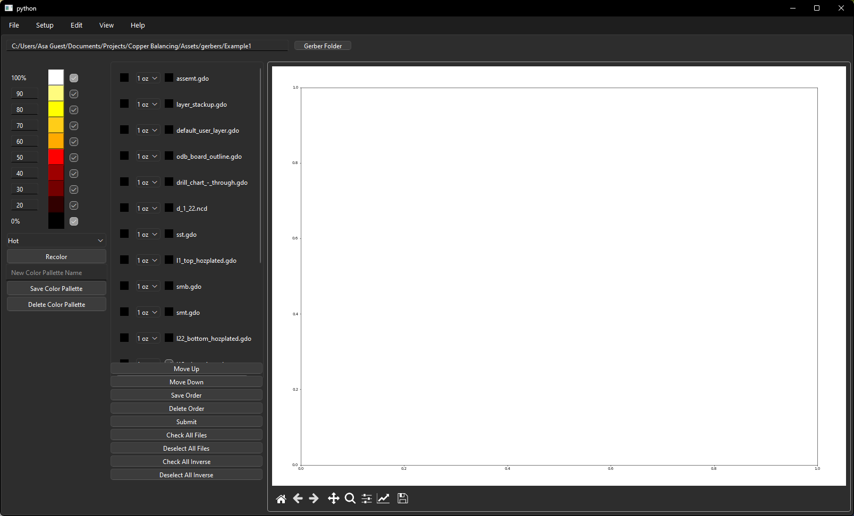
Interface Updates
Additional user defined settings
Layer specific modifications
Sub lamination Analysis

Slide 20
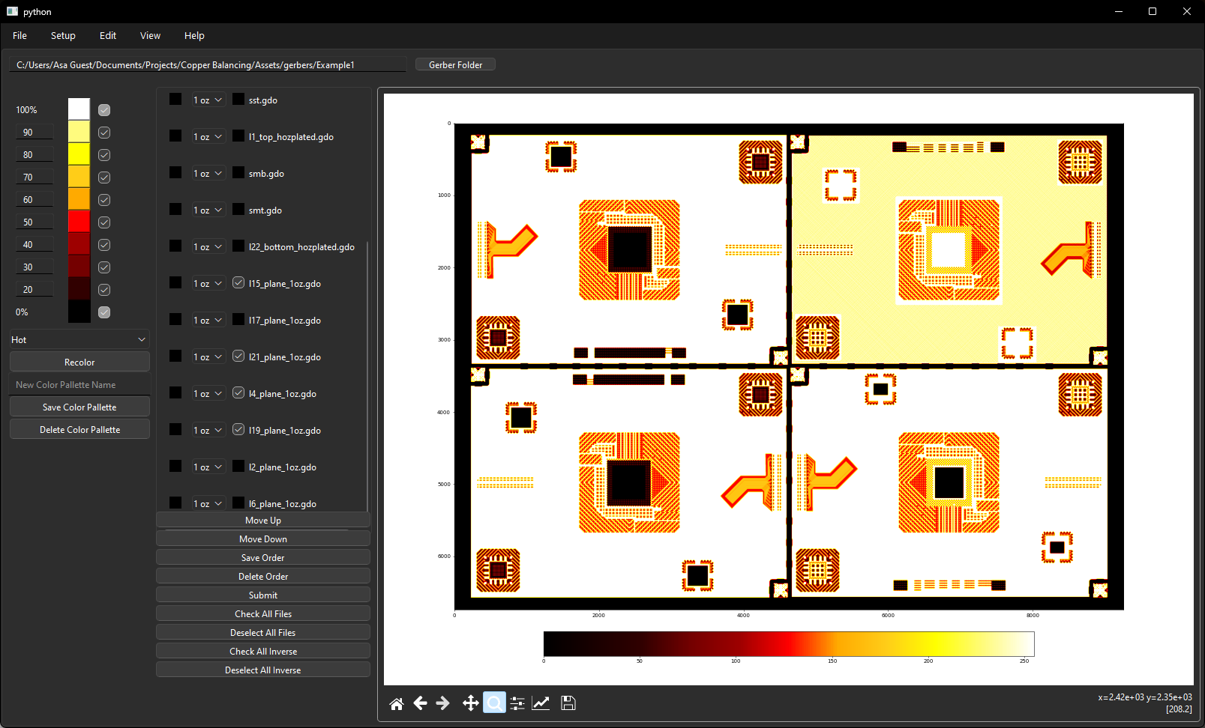
Interface Updates
Sub lamination Analysis

Slide 21
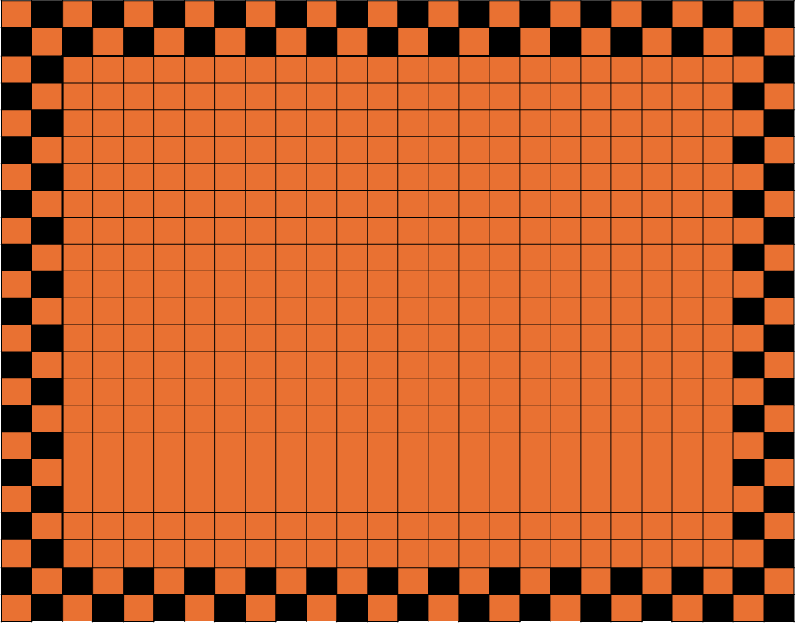
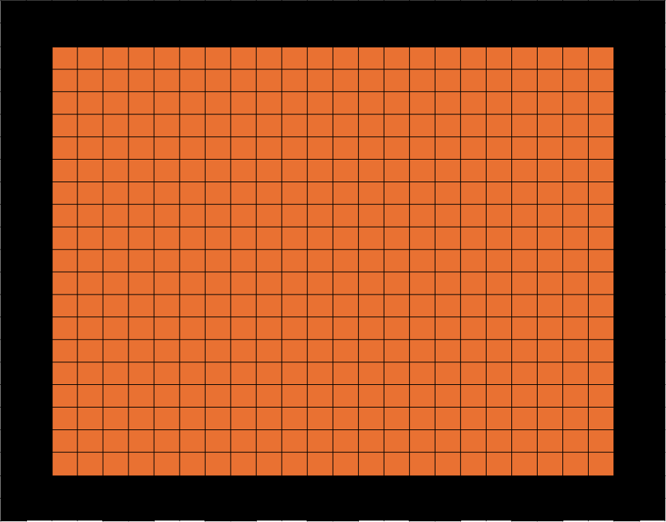
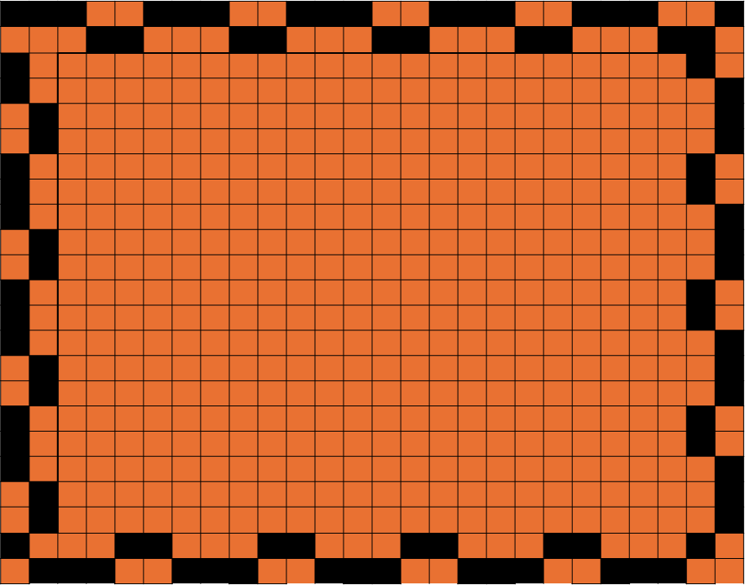
Thieving Updates
For non-manufacturing gerber data, the option to add thieving to the exterior of the panel must be available
Exploring different methods to add patterns that match the kernel size

Slide 22
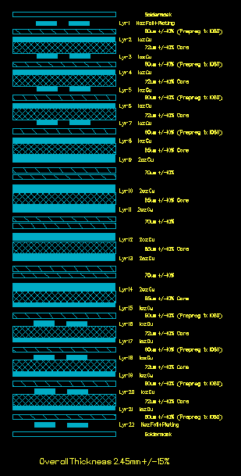
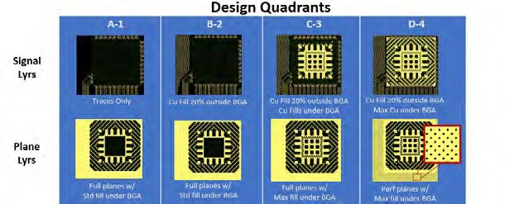
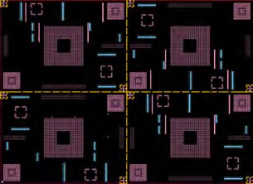
Stackup Modulation of Core Deformation On Hold until initial modeling more complete
Use same TV from Phase 1 (22 layers, w/ six 2-oz layers)
Ensure any builds use same laminate / PCB fabricator combinations
Build A: Increase prepreg thickness next to 2-oz layers by 100-150%
Change the resin volume to match or exceed fill rate of adjacent 1-oz layers
Goal to minimize or even flip direction of core deformation toward center
Build option B: Fabricate the center 2-oz layers as sublam to decouple 1-oz vs 2-oz deformation.
Build option C: Hybrid construction using higher flow materials at center 2-oz
Analysis of surface topography and core deformation same as Phase 1
Builds only require fabrication through panel plate
02/27/2025

Slide 23
Project Flow Chart -
Stackup Modulation of Core Deformation
Supplier 1 | Lower Flow Ultra Low Loss Laminate system Thick Prepreg @ 2oz lyrs 5 panels
Supplier 2
Supplier A | Lower Flow Ultra Low Loss Laminate system Hybrid 5 panels
Supplier B
Supplier C | Lower Flow Ultra Low Loss Laminate system Phase1 stackup w/ sublam 5 panels
Supplier D
Design
(Cmplt)
Fabrication
X-Section – Core Deformation measurements (1-2 panels/mtrl)
Evaluation
Surface Topography (all panel/mtrl)
Data Analysis
Final Report
Analysis Tool Dev
Artwork Dev
Interface Dev
Manual Testing
/ Verification
Deployment
Github Link
Complete

Slide 24
Resources and Schedule
Task | Resource | Planned | Actual
Complete DOE Matrix | All |  | Complete
TV Design ECAD | Intel |  | Complete
PCB Laminate Materials | EMC, Iteq, AGC, TUC | 6/30/25
TV Fabrication | TTM, WUS, VGT, SCC, Founder, SME, ACCL, GCE | 8/30/25
Surface Characterization | Akrometrix, IBM | 10/30/25
Microsection Analysis | IBM | 11/30/25
Final Report | All
MetAve software dev | Artwork Conversion Inc | 16 weeks** | Complete
MetAve Testing / analysis | All | 9/30/25*
Wrapper Dev | IBM | 1/27/25 | 2/10/25
*On going maintenance/work after specified date
Notes:
Contact

Slide 25
Team List
IBM - leader
AGC
Akrometrix
Panasonic
Oracle
Nokia
Juniper
WUS
Resonac
VGT
TTM
EMC
ITEQ
TUC
Co-Tech Development
Sanmina
Intel
Notes:
SCC, Victory Giant, Allied, WUS, TTM

Slide 26
Thank You
For questions or comments on this presentation,
please email: karls@hdpug.org

Slide 27
Backup

Slide 28
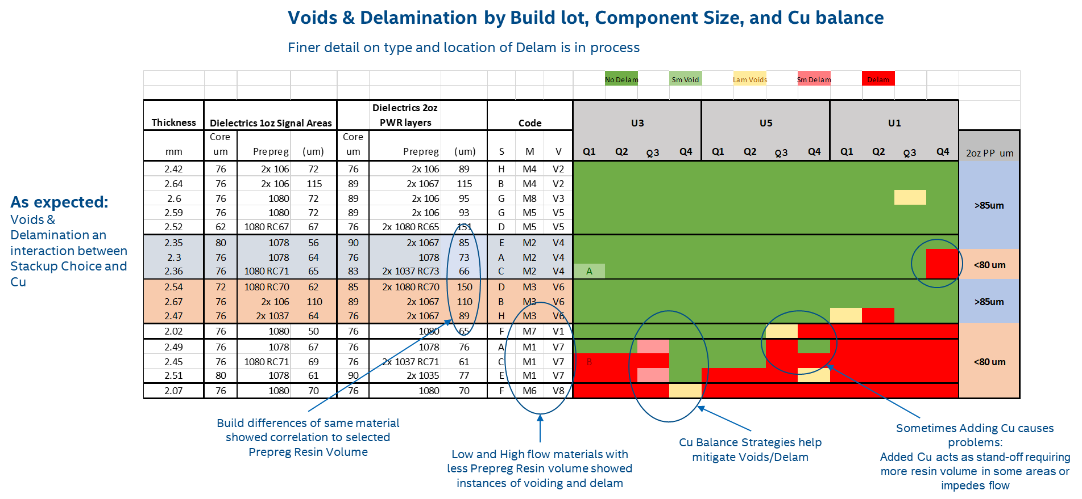
Background - Continued
Stackup-up (prepreg selection matters for thickness control):
For same material prepreg thickness mattered
02/27/2025

Slide 29
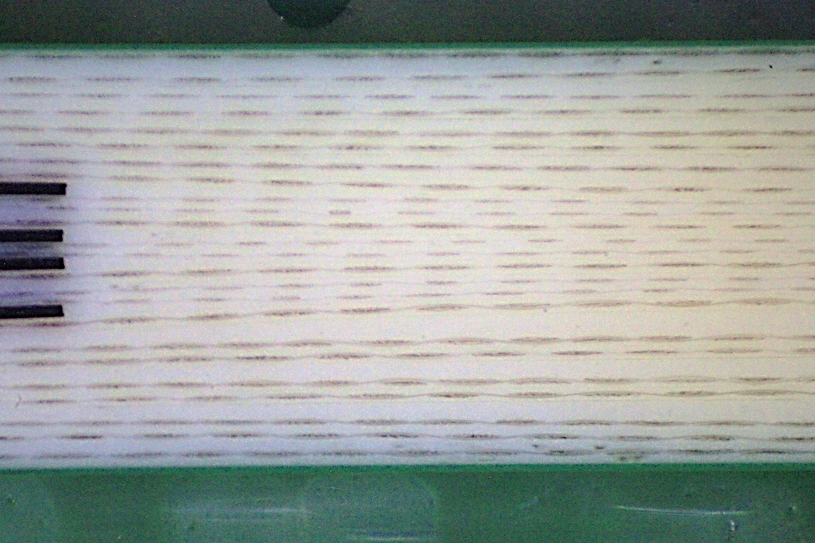
Asymmetry from Symmetric Design & Stackup
Asymmetric location of resin flow and core deformation likely critical to panel-panel variations in Co-Planarity and backdrill layer location.
Hypothesized to be related to book placement. But, outside of scope/focus of Phase 2
Why more resin here?
Stackup is symmetrical
02/27/2025

